Slide 1
Session 482 - Strategies to Improve Care for Advanced Chronic Respiratory Diseases
SIMULATION SUGGESTS TRANSCUTANEOUS CO2 SENSORS MAY ACCURATELY DETECT HYPERCAPNIA ACROSS SETTINGS

Slide 2

Dustin Anderson-Bell, MD
Fellow of Pulmonary and Critical Care Medicine
University of Utah
Intermountain Medical Center
George E Wahlen Veterans’ Affairs Medical Center
Salt Lake City, Utah
Disclosure: None.

Slide 3
Financial Disclosure
This research was supported by funding from
  The National Institutes of Health under Ruth L. Kirschstein National Research Service Award 5T32HL105321
  NCATSs Award UM1TR004409
  The Intermountain Foundation

Slide 4
Lesson Objectives
Why arterial sampling for detection of hypercapnia is problematic
Simulated estimates of test characteristics of Transcutaneous CO2 (TcCO2)
Two-step strategy for using TcCO2 results

Slide 5
Background
Problem:
  Hypercapnia is widespread (~15% of CAP admissions¹, 43% of ARDS²) and consequential (60 day mortality of 12% to 28%³).
  Barriers to reliable identification: Arterial sampling requires expertise and can be painful with possible complications.⁴
    Impacts clinical practice (missed diagnoses) and research (difficult to ascertain prevalence).
Gap:
  TcCO2 may allow for greater sampling of CO2 without the downfalls of ABGs but its performance in different settings isn’t known.
1 - PMID: 22677348
2 - PMID: 32589951
3 - PMID: 22586805
4 - PMID: 26628461

Slide 6
Relevant prior work
Conway et al 2017:
  Meta–analysis of 73 studies comparing PaCO2 and TcCO2 to obtain pooled bias, limits of agreement (incorporating uncertainty from within- and between-study variance), including within different populations.
  Pooled bias only -0.1mmHg but wide limits of agreement (±15mmHg) outside of clinically acceptable range.
  Rates of misclassification therefore difficult to predict given wide uncertainty.
TriNetX Database: Nationwide data set from 76 medical centers reporting data on 115 million patients including PaCO2 for those who underwent ABG sampling.

Slide 7
Aim of current analysis
Estimate TcCO2 accuracy (Se/Sp/PPV/NPV) for detecting hypercapnia in a range of settings (Ambulatory, ED/inpatient, ICU) by applying published TcCO₂–PaCO₂ agreement (Conway 2017) to the distribution of observed PaCO2 values in a national cohort (TriNetX).

Slide 8
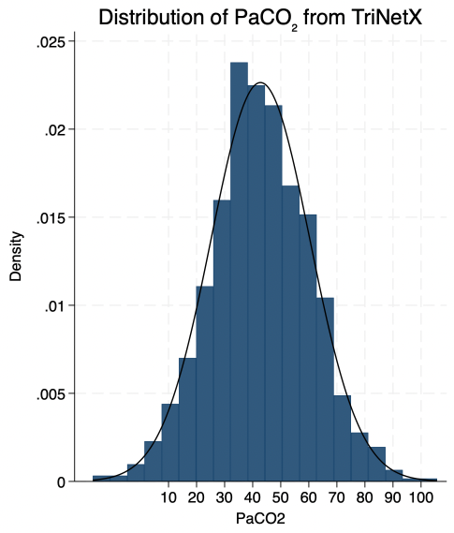
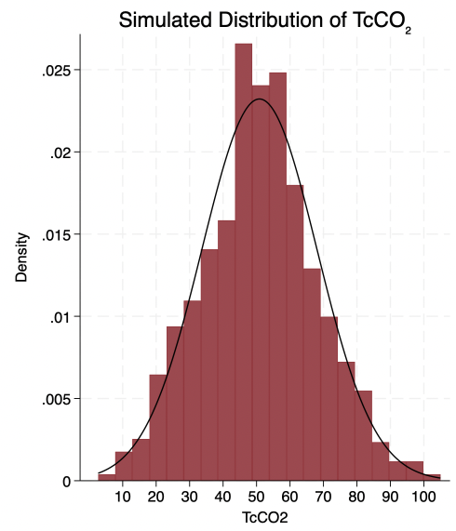

Methods
PaCO2 distribution from TriNetX;
Split by location of ABG sampling
Simulate a TcCO2
for each PaCO2
Distribution of true/false classification
PaCO2
Inpatient + ED
(n=91, 503)
FP
TriNetX Database
- All encounters with an ABG 01/01/22 – 12/31/22
TcCO2<45
PaCO2<45
TN
ICU
(n=66,704)
Location-specific Bias
+ Uncertainty
TcCO2>45
PaCO2>45
TP
Ambulatory
(PFT Lab)
(n=10,456)
TcCO2
Stata Code:
FN
Notes:
https://www.qrcode-monkey.com used for QR code to my github https://github.com/danderson38/TcCO2

Slide 9
Results
 | Median PaCO2 (IQR) | TcCO2 False Positives (PaCO2<45 TcCO2>45) | TcCO2 False Negatives (PaCO2>45 TcCO2>45) | TcCO2 Sensitivity | TcCO2 Specificity | TcCO2 PPV | TcCO2 NPV
Ambulatory | 40.0 (35.7, 45) | 3.8% | 2.4% | 89.8% | 94.4% | 85.2% | 96.3%
Inpatient/ED | 40.0 (35, 46) | 2.0% | 5.1% | 82% | 97% | 91.9% | 92.8%
ICU | 39.0 (33, 47.2) | 3.5% | 2.1% | 93.1% | 94.6% | 89.8% | 96.7%

Slide 10
Results

Slide 11
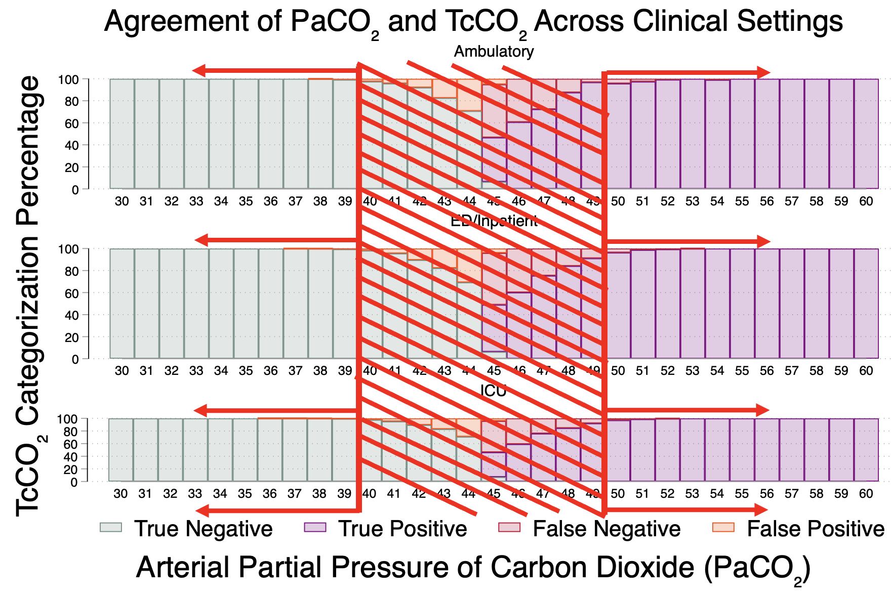
Results
(TcCO2 cutoffs of ≤40 and ≥50)
 | TcCO2 False Positives (PaCO2<45 TcCO2>50) | + LR | TcCO2 False Negatives (PaCO2>45 TcCO2<40) | - LR
Amb | 0.06% | 461 | 0.00% | 0.000
Inp/ED | 0.05% | 1056 | 0.46% | 0.0187
ICU | 0.09% | 551 | 0.05% | 0.0011
Sens/Spec/PPV/NPV all >99%

Slide 12
Limitations
This is an estimation of the accuracy for identification of hypercapnia if applied broadly to all situations where ABGs are currently obtained so difference from actual observed accuracy is possible.
Although ventilation is a continuum we are limiting evaluation of hypercapnia as a dichotomous variable that likely reflects typical decision making (< vs > 45) but this may vary.
Modeling assumes a normal distribution of error in TcCO2-PaCO2 disagreement but this may be an inaccurate assumption.
Specific physiologic states (ie shock), different devices not tested.

Slide 13
Conclusions
TcCO2 seems unlikely to make large mistakes in classification of ventilation status and thus may be useful in evaluating for hypercapnia when downsides of arterial sampling are prohibitive.

Slide 14
Acknowledgments
Brian Locke, MD MSCI
Jeanette Brown, MD PhD
Ramkiran Gouripeddi, MBBS MSc
Wayne Richards

Slide 15
Thank You!
Don’t forget to evaluate this session in the app.

